Slide 1

Zoom Whitening
A whiter smile at home!

Slide 2

Philips Zoom DayWhite Gentle 6% Hydrogen Peroxide + ACP, get the healthier, brighter smile you want without the sensitivity you need. Optimum results within two weeks.

Slide 3
Is it safe?
The safest way to whiten teeth is by using gel prescribed by a dental professional.
Whitening products that you can buy outside of your dentist only contain 0.1% hydrogen peroxide and very little active ingredient to whiten your teeth.
Some products don’t contain any whitening ingredients and contain harmful ingredients such as lemon juice, citric acid and bicarbonate soda to dissolve stains which can be damaging to teeth in the long term.
Therefore, ask your dentist for Philips Zoom! today.

Slide 4
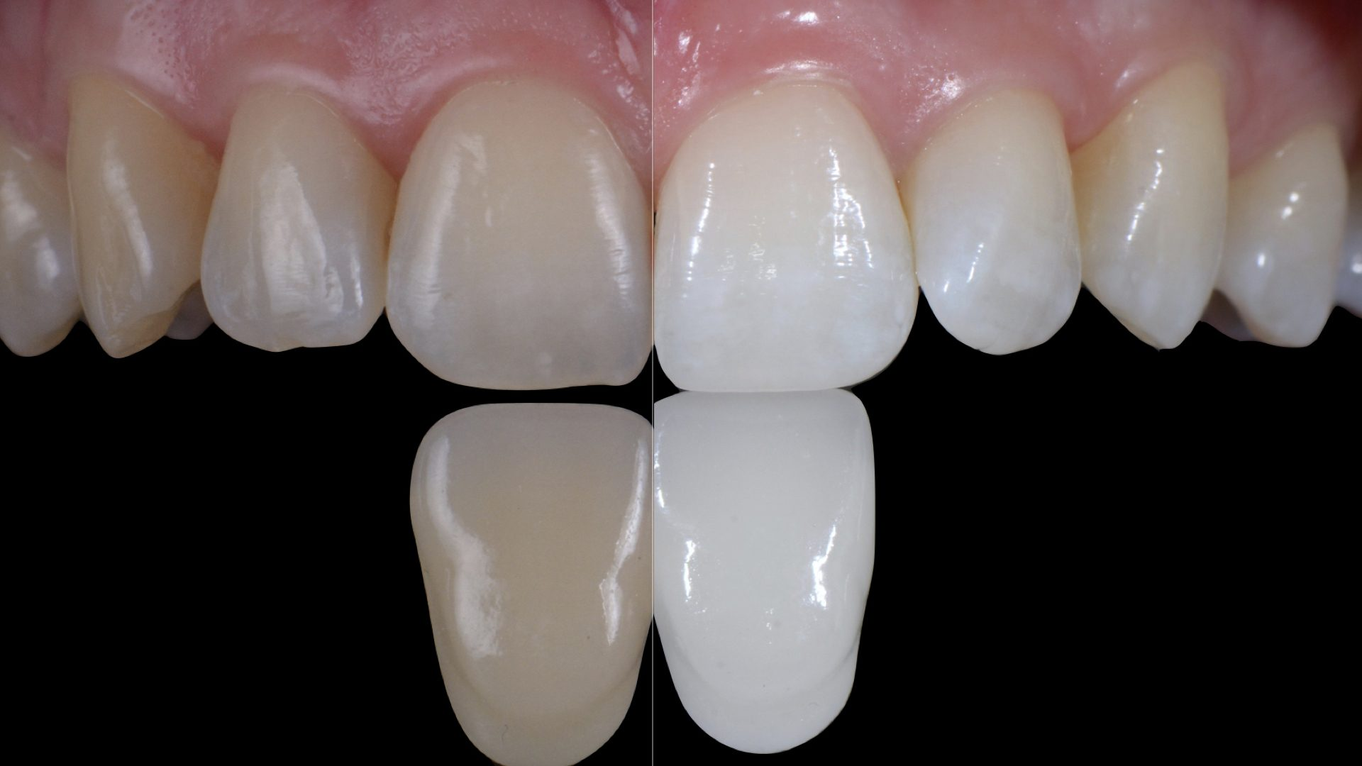
Is it harmful?
Hydrogen peroxide – why is this not harmful?
Professional products contain safe levels of hydrogen peroxide which are more effective, gentle on enamel and custom made.
How does it work? The tooth absorbs the hydrogen peroxide and breaks down the colour molecule to turn the tooth white from the inside as well as removing the stains from the outside.

Slide 5
Does it hurt?
Will it hurt?
Some sensitivity is normal however this can be reduced dramatically with the addition of desensitizing agents. Zoom! take home gels have a unique desensitizer known as ACP that is shown to reduce sensitivity without compromising on result.

Slide 6
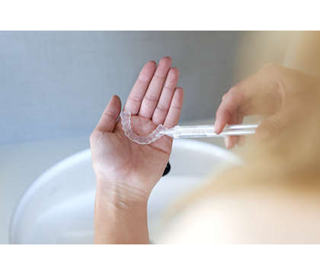
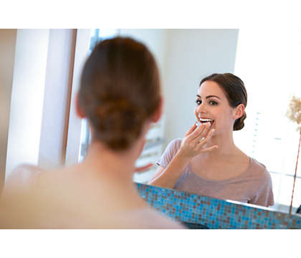
How does it work?
When you’re ready to whiten your teeth, brush well to remove plaque
Put a teardrop size of tooth whitening gel into each impression in your trays
Gently place the trays over your teeth
When the prescribed time for your formulation is up, take out your trays and give them a good clean with cold water
Brush your teeth and enjoy a whiter smile!

Slide 7

Zoom Day White Reviews
Works every time!
I decided to get this done at this dentist for my birthday treat. Before the treatment my teeth were different shades however became white and shiny. I was told to use the home kit treatment to top up every few months, I thought it would be a pain to do however it is the complete opposite. The home kit is easy to use and you only leave it on for 2 hours max! I do get a little sensitivity however my dentist recommended I use my home kit every other day to stop sensitivity, which really works for me. The syringes are really easy to use. I recommend you brushing your teeth before use just to make sure you get the best results. The syringes have a good amount of gel in them as you use a small amount each use. I really recommend this product!!

Slide 8
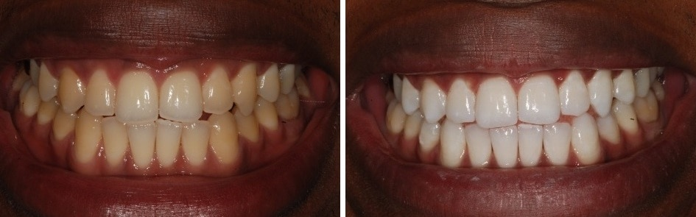
Before and After

Slide 9
How you can get Phillips Zoom?
Let our receptionist know to book in a consultation!
A check up is required before whitening in order to get the best results. Book a whitening consultation and get the go ahead from your trusted professional.
The dentist will take moulds and make whitening trays to fit your teeth perfectly.
Come and collect your trays at a later date, the dentist will make sure you are happy with how the trays fit and you know how to use them.
Your at home whitening kit is now ready to use! Follow the instructions provided using the gels for two weeks and you’ll see a whiter smile from just 3 days!

